Slide 1
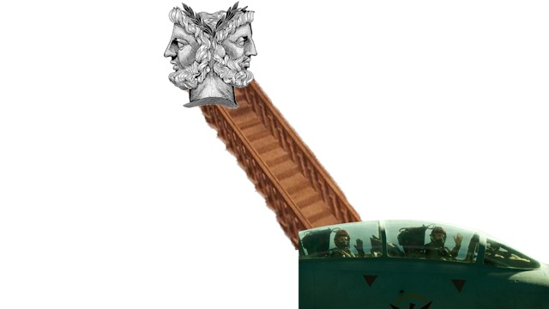
1. I knew
you were trouble
2. There were
pages turned
3. Is it over now?

