Slide 1
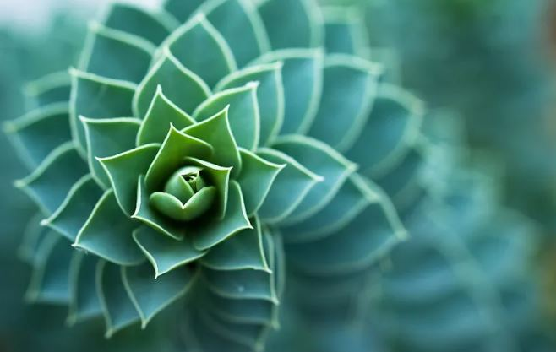
Biomimetic cyclization promoted by Iridium Acylnitrenoid
Nature
Chemist
E. Tufano, E. Lee, M. Barilli, E. Casali, A. Oštrek, H. Jung, M. Morana, J. Kang, D. Kim, S. Chang, and G. Zanoni.; Journal of the American Chemical Society 2023 145 (45), 24724-24735

