Slide 1
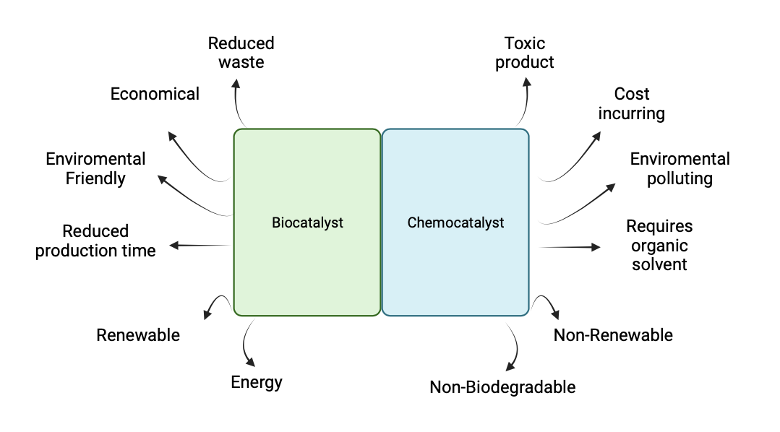
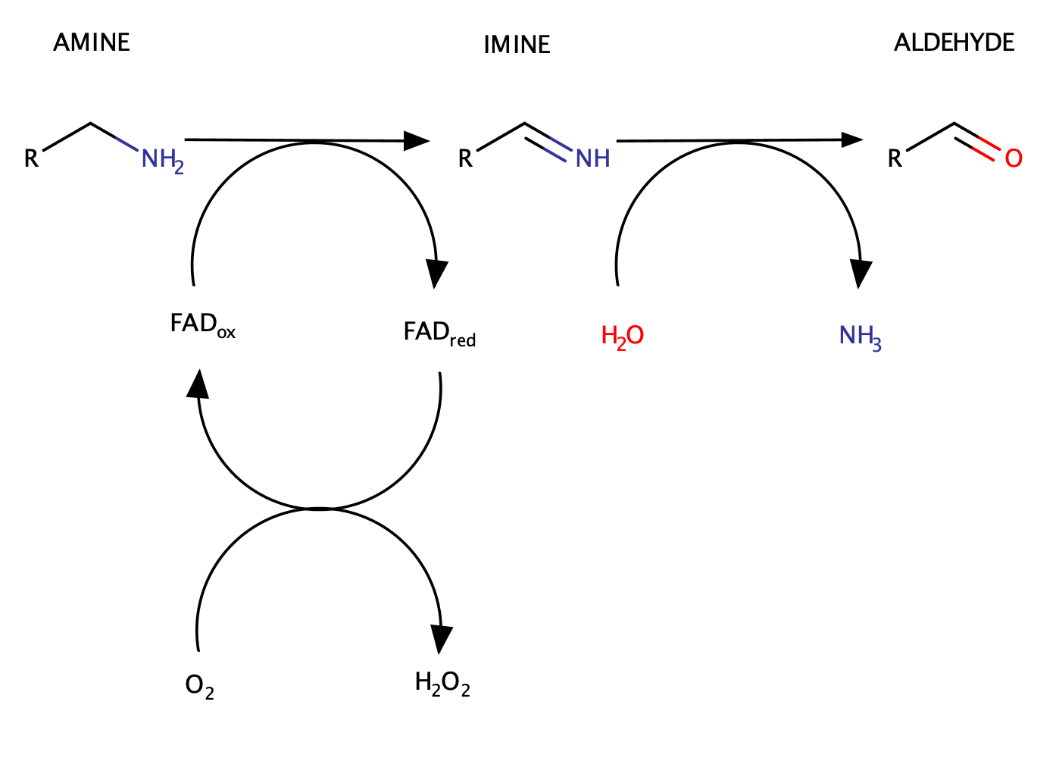
Amine Oxidase enzymes
Amine Oxidase as Biocatalyst
Biochemical Characterization
Discovery of new enzyme from thermophilic bacterium
Biochemical characterization
Structural characterization
Expression and Purification
MAO_{Tb}
Structural Characterization
Conclusion
MAO_{Tb} has a high potential to be engineered. It is possible to design mutants of the enzyme with desired biocatalytic properties.

