Slide 1
Biomedical Physics
19.05.2025 - Presentation of the Master's degree curricula - BIOMEDICAL PHYSICS
M.Sc. in Physical Sciences
General link :
https://scienzefisiche.cdl.unipv.it/en
Link Biomedical Physics :
https://scienzefisiche.cdl.unipv.it/en
Presentation webinar :
https://thestudyabroadportal.com/open-day/biomedical-physics-at-the-university-of-pavia-exploring-the-life-phenomenon-through-the-principles-of-physics/?utm_source=University/
More information :
https://apply.unipv.eu/en_GB/courses/course/172-masters-program-physical-sciences--biomedical-physics-curriculum
https://fisica.cdl.unipv.it/en/node/185
https://scienzefisiche.cdl.unipv.it/it/informazioni-pratiche/guida-dello-studente/guida-dello-studente-laurea-scienze-fisiche-202425
Study plan :
https://scienzefisiche.cdl.unipv.it/en/practical-information/study-plan

Slide 2

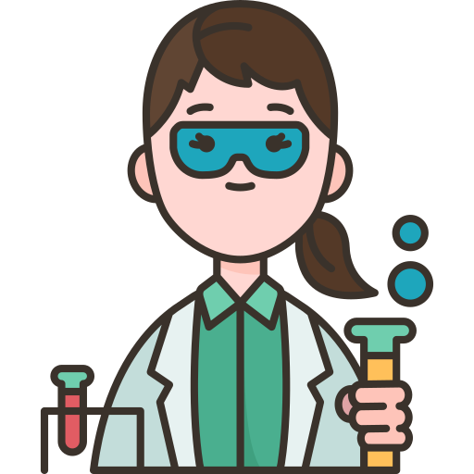

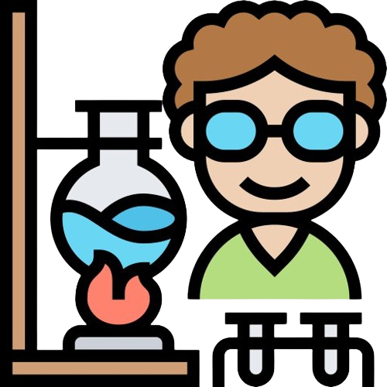
BIOMEDICAL PHYSICS
19.05.2025 - Presentation of the Master's degree curricula - BIOMEDICAL PHYSICS
It is a multidisciplinary field that applies principles and techniques of physics to the study of MEDICINE, biological systems and phenomena
BIOLOGY
MEDICINE
CHEMISTRY
ENGINEERING
MATHEMATICS
INFORMATICS
STATISTICS
…….
…to advance physics knowledge, technology, biomedical science and healthcare!

Slide 3
WHY PHYSICISTS IN THE BIOMEDICAL FIELD?
19.05.2025 - Presentation of the Master's degree curricula - BIOMEDICAL PHYSICS
Medical diagnostic and therapeutic techniques are advancing at a HIGH RATE
When radiation (ionizing and not) is used in medicine, physicists play A pivotal role
Physicists bring crucial technical and theoretical skills, enhancing collaboration with professionals such as physicians, engineers, biologists, mathematicians, chemists, STATISTICIANS, informaticians and others.

Slide 4


BIOMEDICAL PHYSICS PROGRAM
19.05.2025 - Presentation of the Master's degree curricula - BIOMEDICAL PHYSICS
The program focuses on the use of basic and applied research in :
MEDICAL DIAGNOSTICS
CLINICAL THERAPY
HEALTH PROTECTION
IMAGING TECHNIQUES
MRI - CT - PET - SPECT -
ULTRASOUNDS
CANCER THERAPIES
CONVENTIONAL & NEW
RADIOTHERAPY TECHNIQUES
DOSIMETRY
RADIATION PROTECTION
RADIATION BIOLOGY
hadron therapy
neutron capture therapy
hyperthermia
MEDICAL SENSORS
PHYSICAL PRINCIPLES AND MODELS

Slide 5



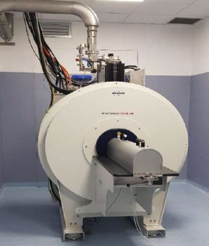
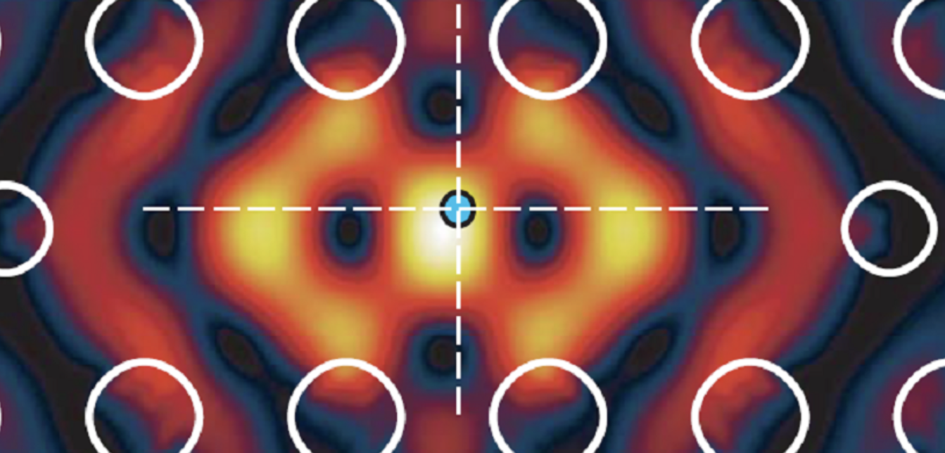

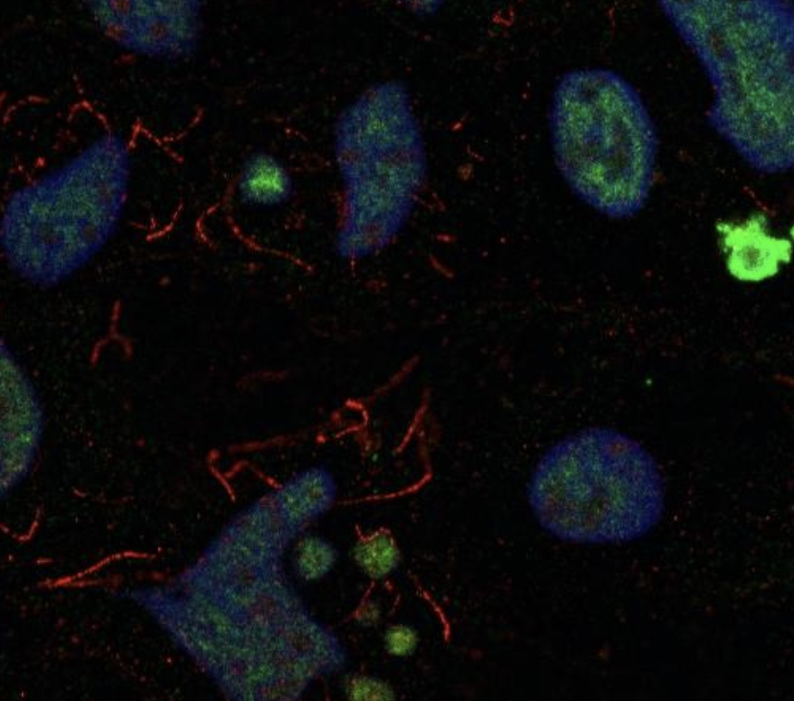
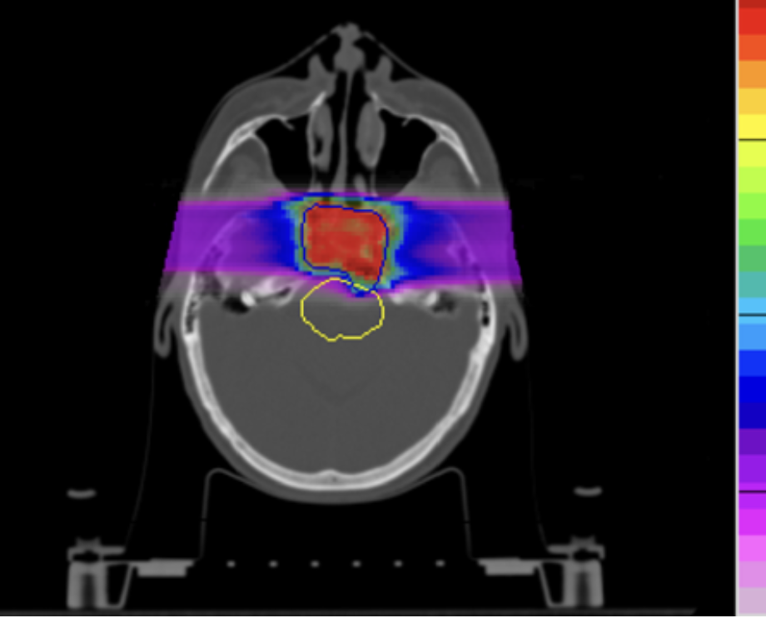
Skills acquired
19.05.2025 - Presentation of the Master's degree curricula - BIOMEDICAL PHYSICS
Instrumentation
DiagnosticS instruments
PHYSICAL TECHNIQUES
PHYSICAL & BIOLOGICAL KNOWLEDGE
Nuclear physics
Solid-state physics
Detectors
Dosimeters
Principles and Models
BIOMARKERS
RADIOBIOLOGY
Mathematical &
computational
methods
SIMULATIONS
PHYSICAL MODELS
AI
STATISTICS

Slide 6
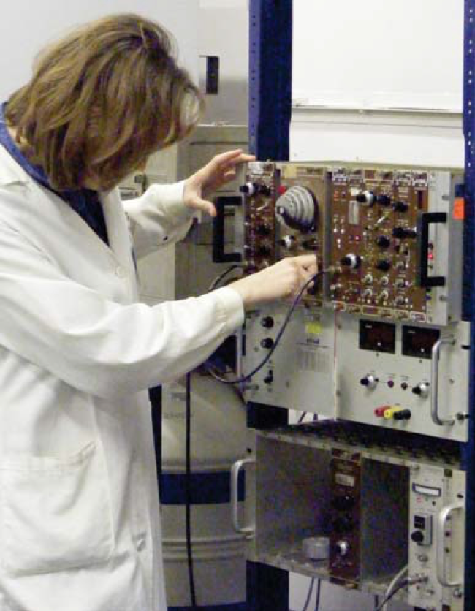
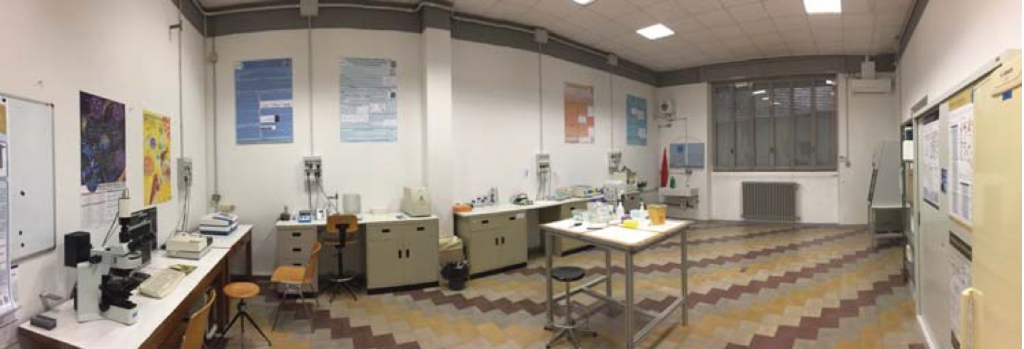
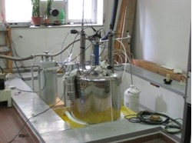
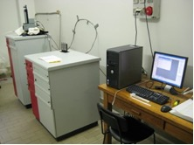
ExampleS of OUR RESEARCH Labs
19.05.2025 - Presentation of the Master's degree curricula - BIOMEDICAL PHYSICS
Radiobiology Laboratory
(G Baiocco, I Guardamagna)
Cellular/Molecular biology, in vitro cells and ex-vivo (from patients). Measurements and models of the effects of ionizing radiation on biological structures (e.g.: DNA damage and repair, cell-to-cell communication, immune system response)
Ionizing Radiation Laboratory
(N Protti)
Use of scintillation detectors, solid-state detectors and instrumentation used in health/environmental physics.
NMR/MRI & SQUID Lab: MRI, nuclear hyperpolarization, nanoparticles for theranostics
(F Brero, P Carretta, M Filibian, A Lascialfari, M Mariani, G.Prando)
Hyperpolarization technique and use of magnetic nanoparticles to enhance MRI images contrast → more effective and/or personalized diagnosis

Slide 7
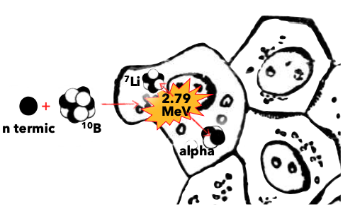
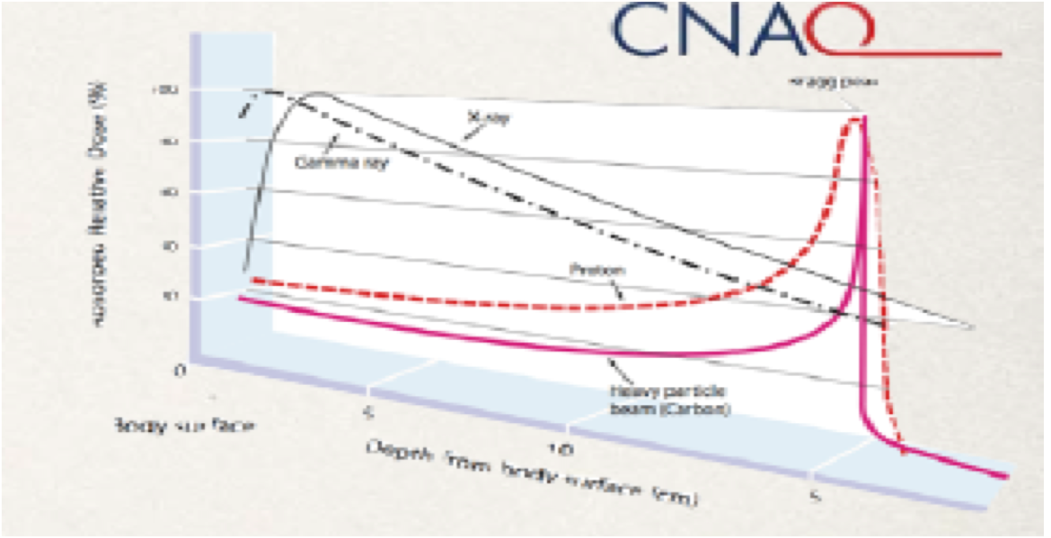
ExampleS of OUR RESEARCH ACTIVITIES (ONCOLOGIC THERAPY)
19.05.2025 - Presentation of the Master's degree curricula - BIOMEDICAL PHYSICS
Boron Neutron Capture Therapy
(S Bortolussi, N Protti, I Postuma, S Fatemi)
Cell-selective radiotherapy via neutron capture on ¹⁰B
Risk of secondary tumors and complications and applications of microdosimetry in particle therapy
(G Baiocco, I Guardamagna)
Simulations for Hadron Therapy
(F Ballarini, M Carante, R Ramos)
Calculation of effectiveness in eliminating tumor cells (and the probability of damaging healthy cells) for ion beams used in hadron therapy (protons, C ions, and He ions)
Plasmonic nanostructures for photothermal therapy and SERS imaging
(M Patrini, P Gallinetto)
Magnetic Fluid Hyperthermia
(F Brero, A Lascialfari, M Mariani, P Carretta)
A technique that uses magnetic nanoparticles with therapeutic properties, thanks to the local release of heat that weakens tumor cells
INTERNATIONAL GEANT4 SCHOOL
Free participation for LM students !!
Educational event aimed at exploring the advancements of the Geant4 toolkit in the field of medical physics with special lectures dedicated to Geant4_DNA.
https://agenda.infn.it/event/37741/

Slide 8
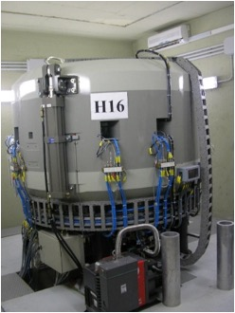
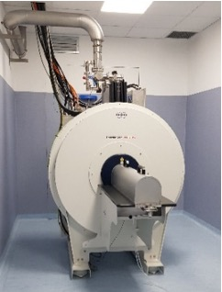
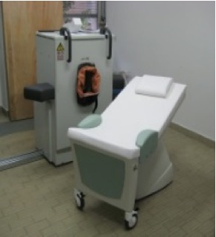
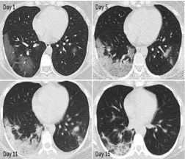
ExampleS of OUR RESEARCH ACTIVITIES (diagnostics)
19.05.2025 - Presentation of the Master's degree curricula - BIOMEDICAL PHYSICS
Radioisotopes for theranostics
(A Fontana, M Carante)
Study of cross sections for the identification of new radioisotopes suitable both as therapeutic agents and as diagnostic agents.
Production of radioisotopes for imaging
(LENA –Applied Nuclear Energy Laboratory)
The LENA cyclotron produces F-18 daily, used for PET (Positron Emission Tomography) imaging
Magnetic Resonance Imaging (MRI)
(F Brero, P Carretta, M Filibian, A Lascialfari, M Mariani)
Research on new materials, software, and technology for MRI for diagnostic and therapeutic purposes
Imaging data analysis, Artificial Intelligence, and Radiomics
(F Brero, S Bortolussi, S Fatemi, M Filibian, A Lascialfari, I Postuma)
Physical/statistical analysis of diagnostic images to obtain quantitative information on disease progression

Slide 9
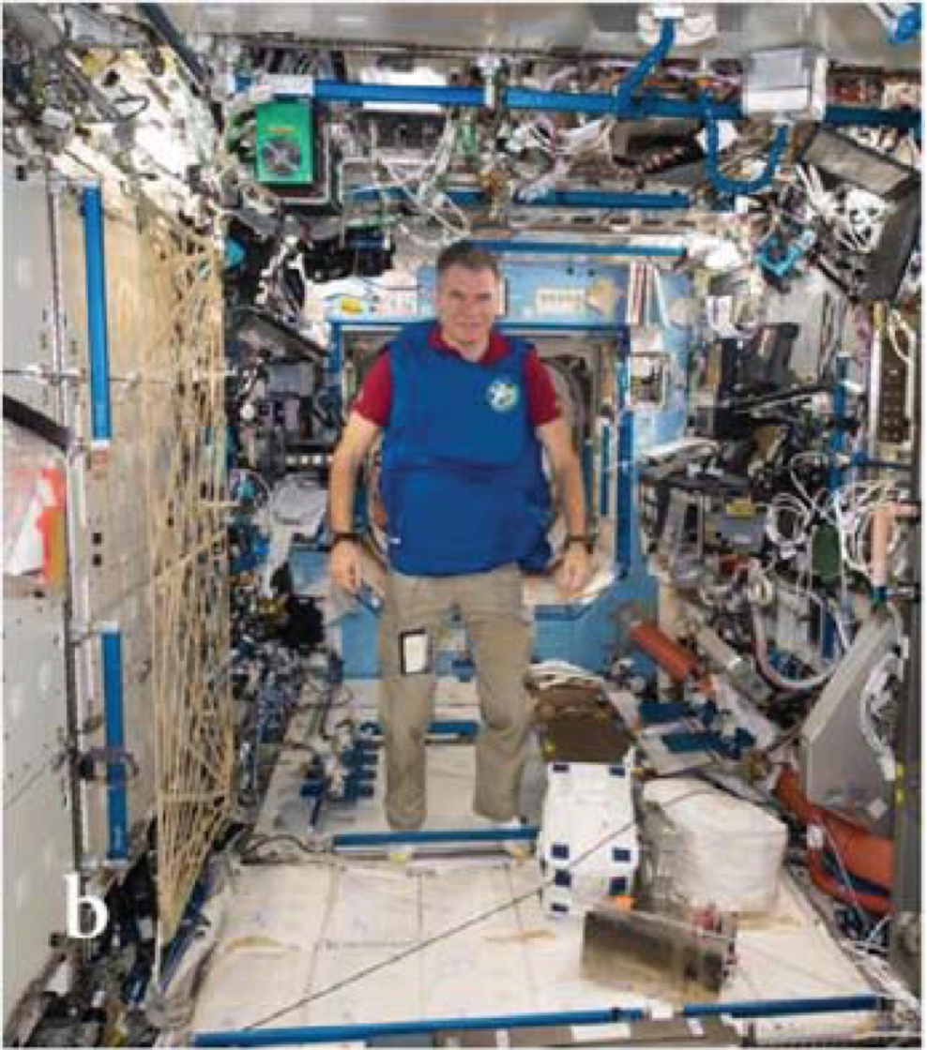
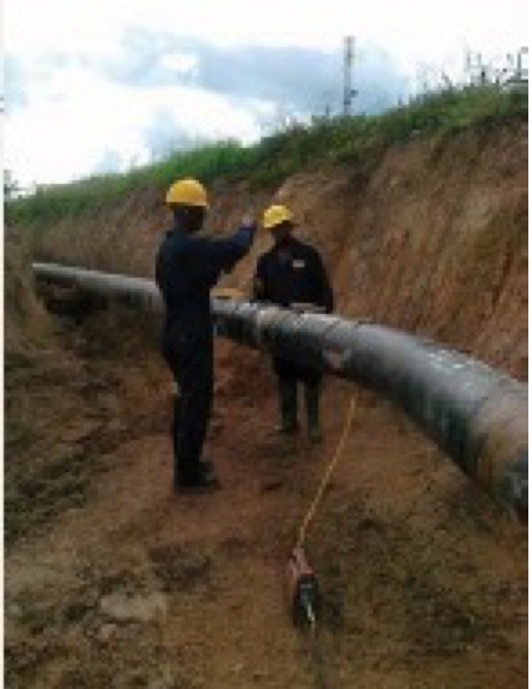
ExampleS of OUR RESEARCH ACTIVITIES (radio-protection)
19.05.2025 - Presentation of the Master's degree curricula - BIOMEDICAL PHYSICS
Radiation protection in industry
(E Giroletti)
Issues relating to the use of radiation in industry and the consequent radiation protection of workers are addressed
Radiation protection in space
(G Baiocco, I Guardamagna, F Ballarini, M Carante, R Ramos)
Dose calculations to astronauts in various space radiation exposure scenarios, with attention to the role of shielding

Slide 10

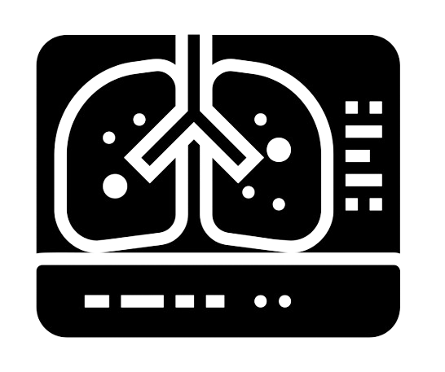


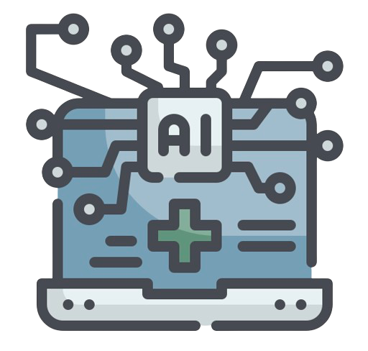
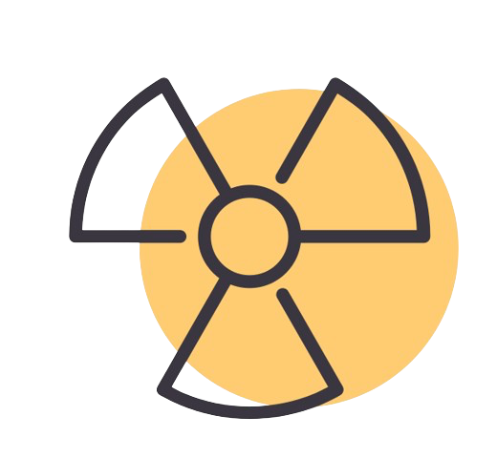
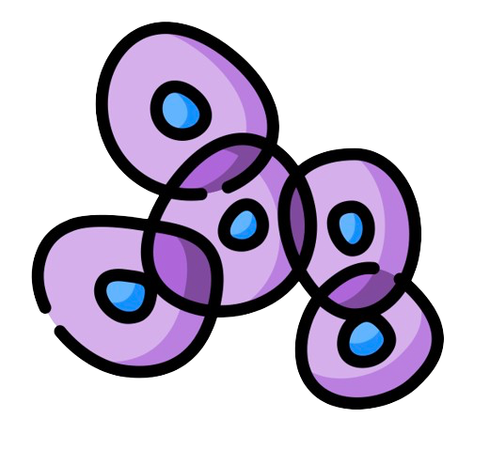

AN Example of RESEARCH TOPICS (SKILLS ACQUIRED)
19.05.2025 - Presentation of the Master's degree curricula - BIOMEDICAL PHYSICS
RESEARCH IN ONCOLOGY
IMAGING
Image analysis AND TREATMENT (AI)
SENSORS FOR BIOMARKERS
INNOVATIVE RADIATION TREATMENTS
EFFECTS AT CELLULAR AND SUBCELLULAR LEVEL
COMPUTATIONAL RADIOBIOLOGY & BIOPHYSICS
AN IMPORTANT COLLABORATION WITH NATIONAL INSTITUTE FOR NUCLEAR PHYSICS

Slide 11
Study plan – 120 ECTS – 2 years
19.05.2025 - Presentation of the Master's degree curricula - BIOMEDICAL PHYSICS
ENTIRELY IN ENGLISH
1 ECTS credit = 1 CFU credit
48 CFU (of which : 6 CFU in FIS/02 or FIS/08, 1 class ; 12 CFU in FIS/04 or FIS/03, 2 classes ; 30 CFU in FIS/01 or FIS/07, 5 classes ) to be acquired by 8 classes from the following table:
12 CFU, 2 classes, from the following table :
12 CFU, 2 classes, to be acquired with electives.
For example one can choose transversal classes :
36 CFU Thesis training
6 CFU Other activities
6 CFU Final exam

Slide 12
LM+
19.05.2025 - Presentation of the Master's degree curricula - BIOMEDICAL PHYSICS
Thesis & INTERNSHIPS - Companies and hospitals
STELAR SRL BRACCO SPA
LENA BRUKER SRL
FONDAZIONE CNAO National/International networks of research groups
OTHER HOSPITALS (also within collaborations for Italian/European Projects)
INTERNSHIP AT CENTERS/COMPANIES
Prof. Pietro Gallinetto - Coordinator (pietro.gallinetto@unipv.it)
Examples : Bracco Imaging - Fondazione CNAO

Slide 13

PhD
19.05.2025 - Presentation of the Master's degree curricula - BIOMEDICAL PHYSICS
AFTER THE MASTER’S DEGREE?
Specialization school in medical physics
With possibility to stay abroad up to 1.5 years (daniela.rebuzzi@unipv.it)
Double PhD with Universidad San Martin – Buenos Aires
To work in hospital/health facilities
Radiation protection expert
Companies
developing medical technologies
2° level Master Degree (asalvini@unipv.it,
nicoletta.protti@unipv.it)
to carry on tasks regarding radiation
safety compliance
https://lena.unipv.it/en/master-of-radiation-protection/
Freelance
& consulting
…and more!
SECONDARY AND
HIGH SCHOOL TEACHING

Slide 14
19.05.2025 - Presentation of the Master's degree curricula - BIOMEDICAL PHYSICS
Do you want to know more ?
...feel free to contact us!
Teaching staff
alessandro.bacchetta@unipv.it
giorgio.baiocco@unipv.it
francesca.ballarini@unipv.it
silva.bortolussi@unipv.it
alessandro.braghieri@pv.infn.it
francesca.brero@unipv.it
mariopietro.carante@unipv.it
susanna.costanza@unipv.it
alessandro.lascialfari@unipv.it
giacomo.livan@unipv.it
manuel.mariani@unipv.it
paolo.pedroni@pv.infn.it
fulvio.piccinini@pv.infn.it
giacomo.polesello@pv.infn.it
ian.postuma@pv.infn.it
nicoletta.protti@unipv.it

Slide 15
THE END
19.05.2025 - Presentation of the Master's degree curricula - BIOMEDICAL PHYSICS

