Slide 1
Master degree in
Physical Sciences
(Laurea Magistrale in Scienze Fisiche)
Prof. Dario Gerace (Coordinator)
Department of Physics “A. Volta”
(website: https://scienzefisiche.cdl.unipv.it/it)
LM in Scienze Fisiche

Slide 2
Admission pre-requisites
Bachelor in STM (Physics or equivalent)
>60 CFU in FIS* sectors, >15 in MAT* sectors (or equivalent), >3 CFU English language
Educational Goals
LM in Scienze Fisiche
Access to PhD, specialization, first and second level Master courses
Direct access to jobs in the private or public sectors

Slide 3
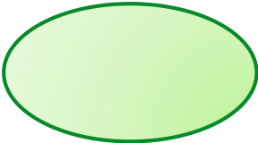


Academic path
72 CFU (12 courses of 6 CFU)
48 CFU Final dissertation (Tesi di Laurea)
~60 courses from the LM Scienze Fisiche
~40 Professors affiliated to the Department of Physics +14 contract Professors (INFN, CNR, INAF, CNAO,...)
6 curricula (1 English, 5 ‘English friendly’, 2 DD):
Fisica della
LM in Scienze Fisiche
Materia
Fisica Teorica
Fisica Nucleare
e Subnucleare*
* Double Degree with Paris Cité
Didattica e Storia
Fisica delle
Tecnologie
Quantistiche
della Fisica,
* Double Degree with Paris Cité
Comunicazione Scientifica
*
Biomedical Physics**
** in English

Slide 4
Admission
Students with a Bachelor degree in Physics (or equivalent)
All students MUST apply to the ‘Concorso di Ammissione’ (https://portale.unipv.it/it/didattica/corsi-di-laurea/ammissioni/iscriversi-ad-una-laurea-magistrale/lauree-magistrali-ad-accesso-libero)
Students with final bachelor mark >92/110 are admitted
Students with lower mark, or a bachelor degree not in Physics will be interviewed (next date: September 14, 2026)
LM in Scienze Fisiche
Students with a foreign Bachelor degree (Physics)
Please apply through: https://apply.unipv.eu/en_GB/courses/course/172-masters-program-physical-sciences--biomedical-physics-curriculum

Slide 5

Career (study) plan
Online procedure with fast approval for the 6 curricula
Possibility to propose a personalized study plan
(to be approved by the Educational Board)
Fisica Teorica
Fisica della Materia
Biomedical Physics (English)
Fisica Nucleare e Subnucleare (with DD in Particle & Astroparticle Physics)
Fisica delle Tecnologie Quantistiche (with DD in Physics and Applications of QT)
LM in Scienze Fisiche
Didattica e Storia della Fisica, Comunicazione Scientifica

Slide 6
LM - Scienze Fisiche in Pavia
130 researchers (personnel affiliated to the Physics Department + personnel of external Research Institutions)
the Physics Department has been (2018-2023) one of the 7 best Physics Departments in Italy (Dipartimenti di Eccellenza)
Very good ratio between number of students/teachers (~6/1)
LM in Scienze Fisiche
Courses are English Friendly or fully in English
~150 students currently enrolled (as of 05/2026)
First year students increasing (33/’21; 54/’22; 80/’23; 50/’24;...)

Slide 7


LM - Scienze Fisiche in Pavia
High level of post-degree satisfaction (80-90%)
LM+ stage in private companies (5 semesters instead of 4, 2 of which spent in the company, with a monthly allowance)
High employment rate (>90% after 3 years from degree)
International indicators: (20% students with >12 CFU abroad)
LM in Scienze Fisiche

Slide 8
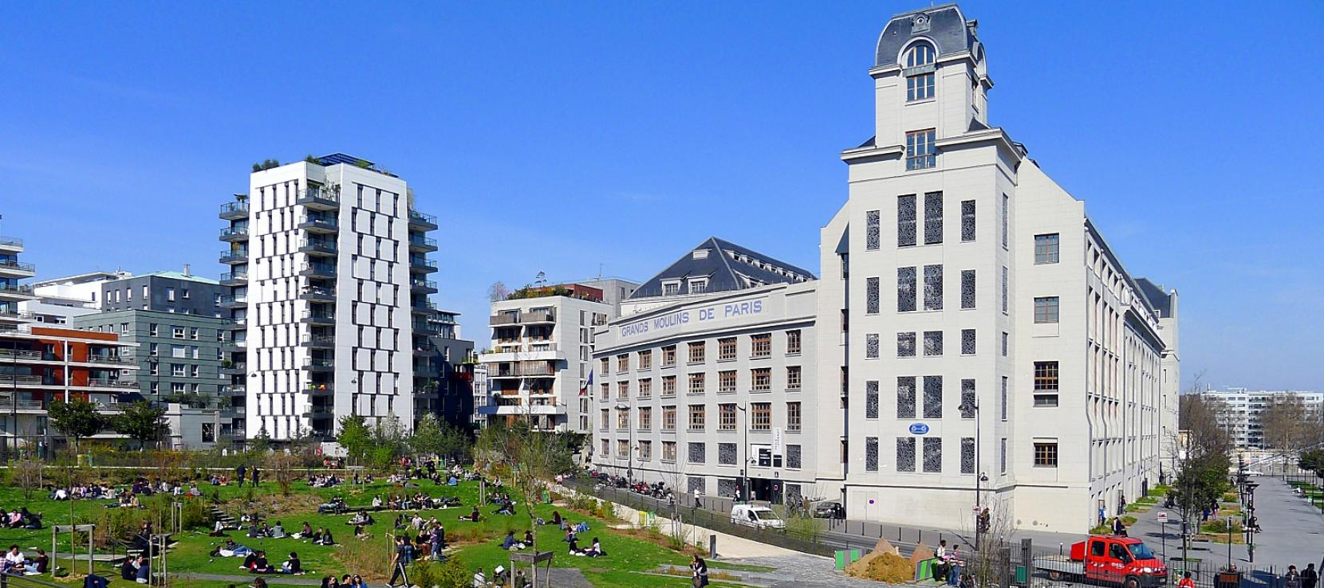
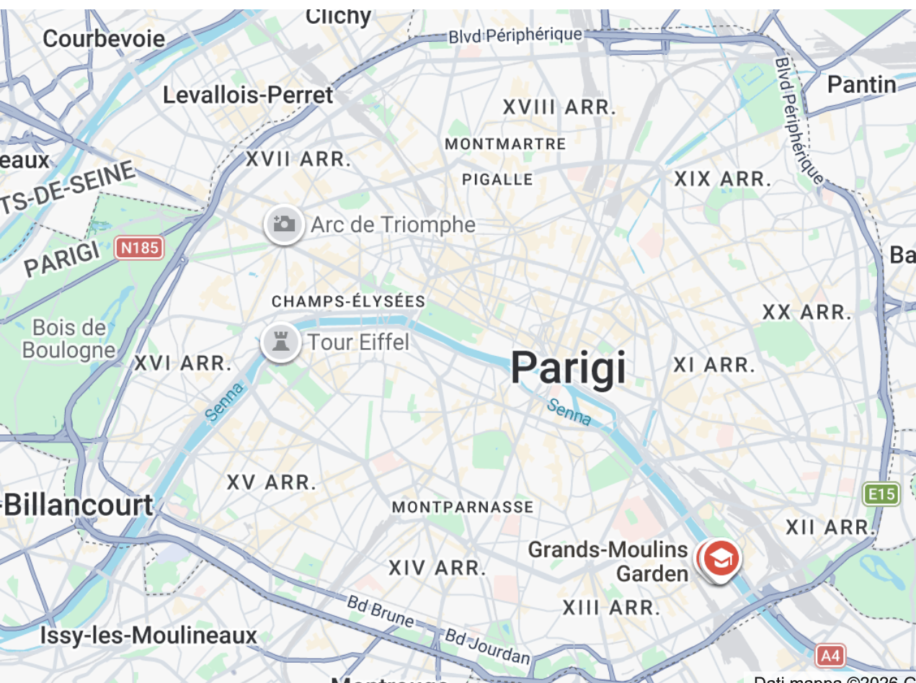
Double Degrees with Université Paris Cité
M1 in Pavia, M2 in Paris (60 CFU in Italy + 60 CFU in France)
Particle and Astroparticle Physics
(since 2023, 3 Italian students + 2 French)
Physics and Applications of Quantum Technologies (NEW!)
LM in Scienze Fisiche

Slide 9
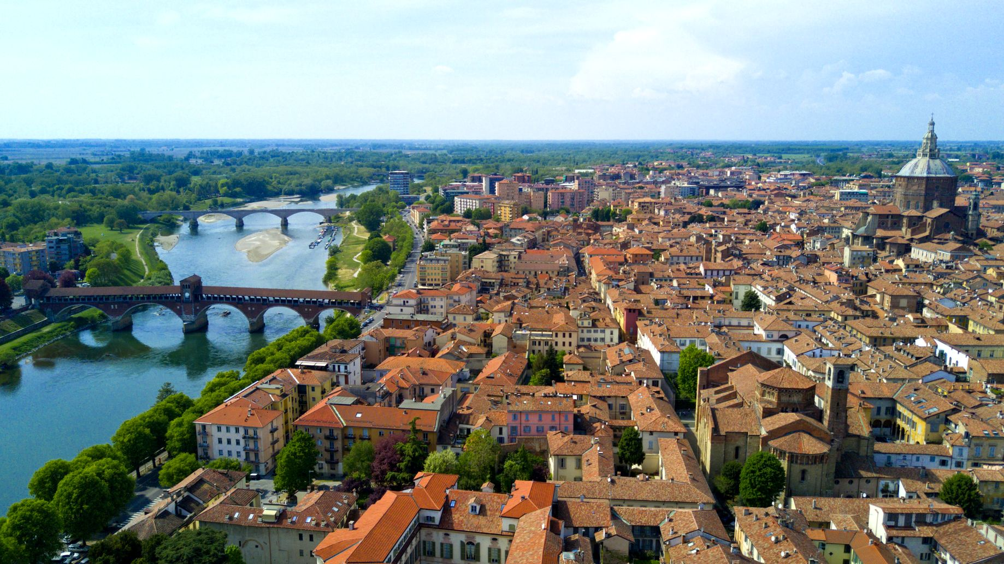
University of Pavia (since 1361)
LM in Scienze Fisiche

